Slide 1

(Events App)
By: Jeremy Aranguren, Nora Bonifas, Maya Gocal, Linette Maliakal, and Janeen Soria

Slide 2
Summary
Purpose
Allow people to find a fun event in their area
Meet people who would like to attend an event with you
Help users make new friends with similar interests
Help users find places where they can participate in something they are interested in
Structure
Apache Cordova
Firebase
HTML, CSS, and JavaScript
Geolocation plugin
Google Maps API
Notes:
Jeremy

Slide 3
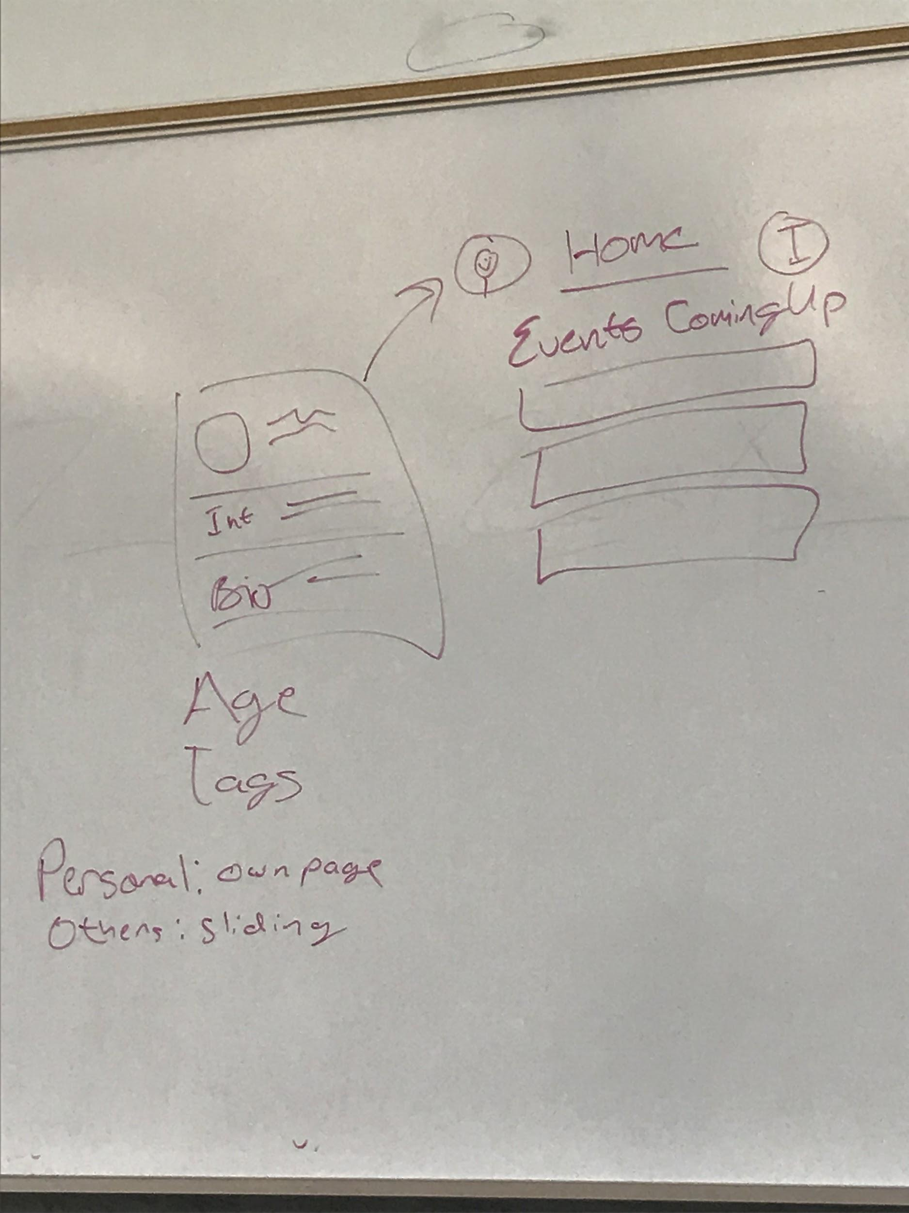
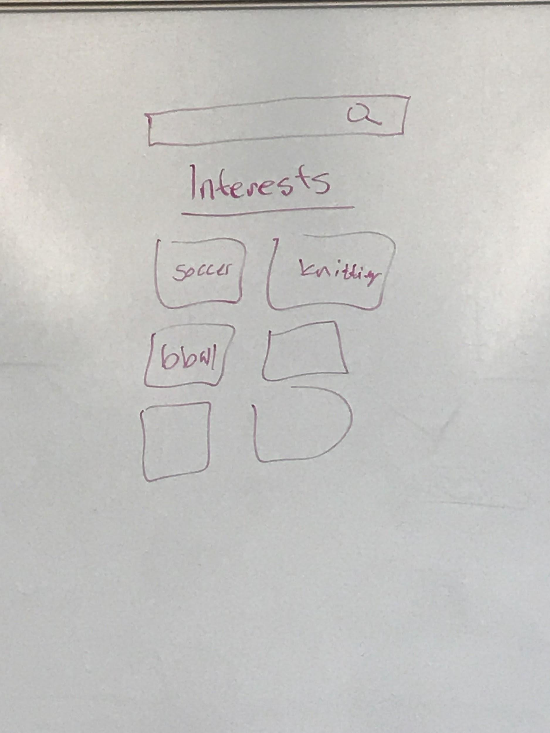
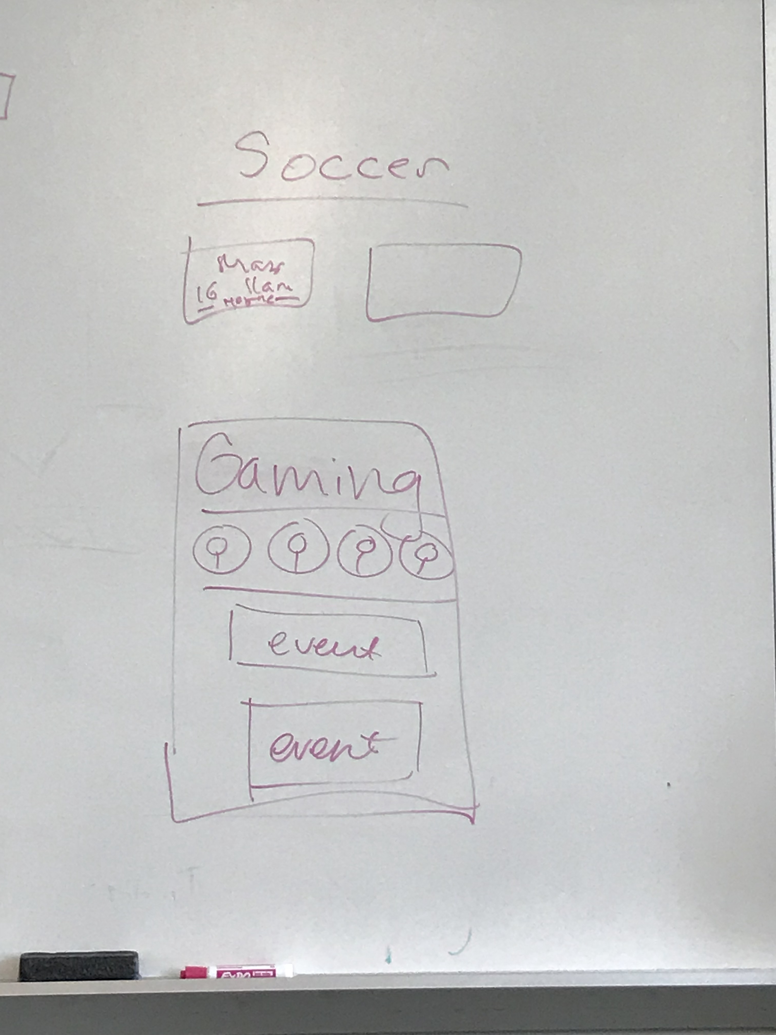
Initial Sketches
Notes:
Jeremy

Slide 4
Architecture
Splash Screen
Events Screen (also the home screen)
Individual events screens
Displays more details about the event
Interests Screen
Individual interest screens
Allows user to view how many people share the same interest
Allows user to find events related to that interest
Profile Screen
Shows user their picture, name, and age
Displays their saved interests
Shows events they are going to attend
Notes:
Janeen

Slide 5
Firebase
Completed
Structure of information on events in json file
Authentication
TODO
Archiving of past events
Gathering coordinates of events generated from map function
Addition of new event info into db
Associating interests with various events
Authentication storage
Need to store usernames and passwords using Linette’s account
Notes:
Linette/Nora
Linette: (when making event, user could customize what their event would fall under i.e. sports but limit to doing 3-5 interests per event so event not so broad)

Slide 6
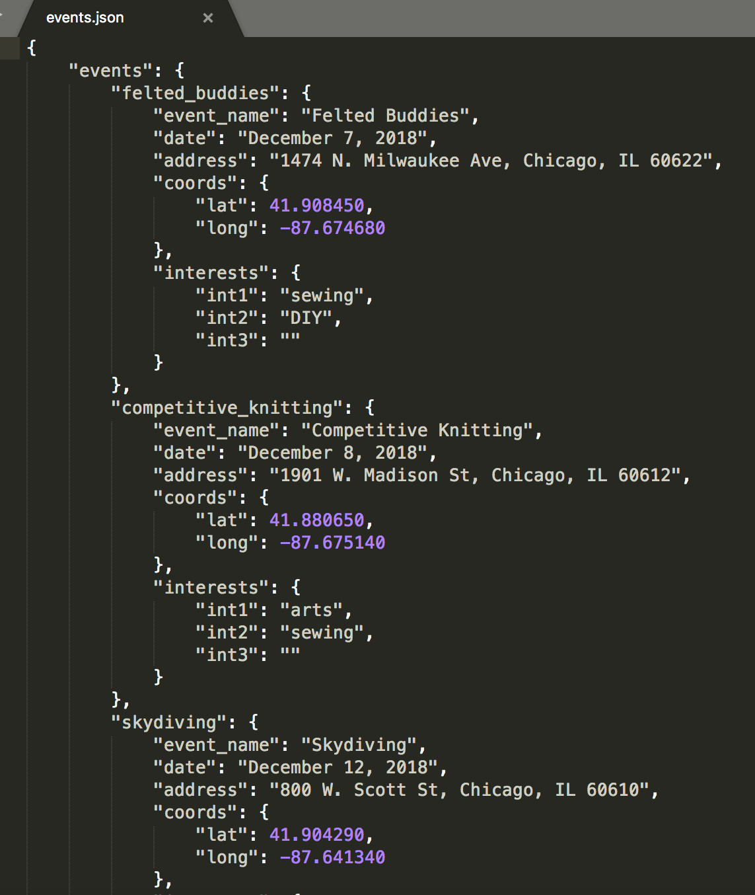
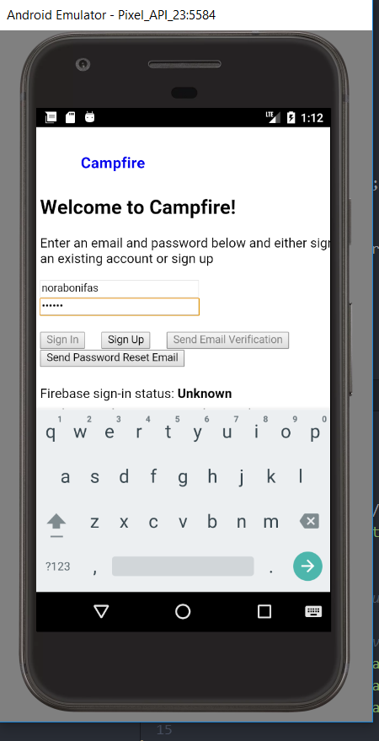
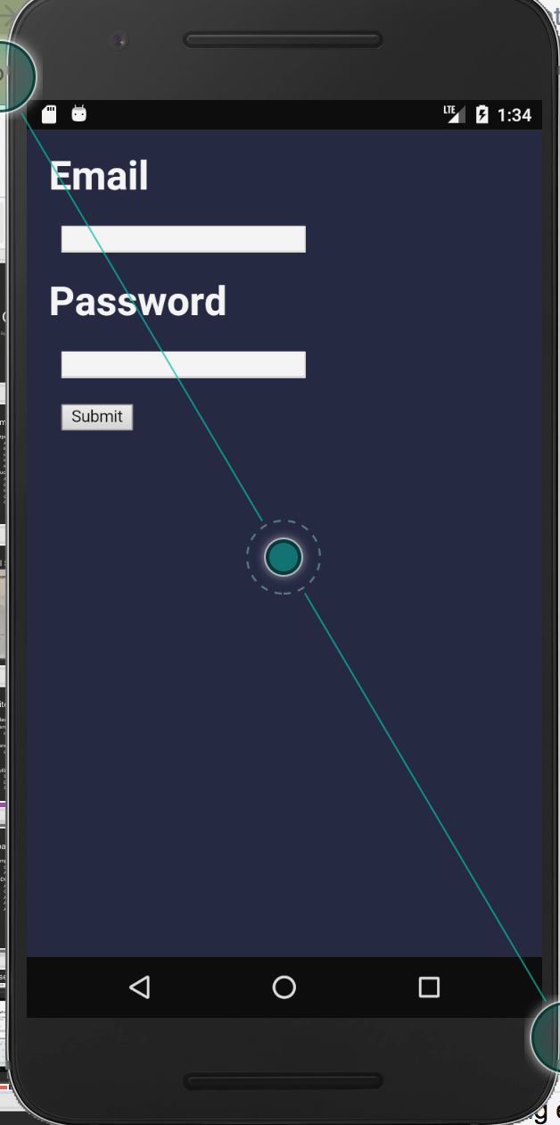
Firebase
Notes:
Nora/Linette

Slide 7
Design
Navigation bar
Icons:
Easier for users to distinguish
More pleasing to see than using text for navigation
Boxes
Events and Interests
Grouping: different colors and have different sized boxes so users can easily differentiate them
Rectangles = dark green, events
Squares = dark purple, interests
Notes:
Janeen- navigation bar
Maria
Grouping: if they look the same and/or they’re next to each other, people associate them together

Slide 8
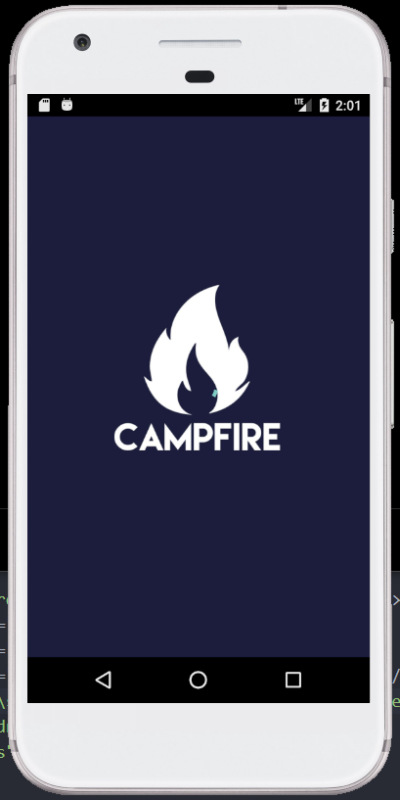
Design
Chosen name (Campfire)
It’s a gathering
Campfires are associated with connecting with other people
Can be associated with a new experience
Colors
Idea of blue flames in a fire
Coolors.co
Went through many different colors
Choose darker colors since campfires are usually done in dark settings
Splash Screen
Simple, minimalistic but not ordinary design
Notes:
Maria

Slide 9
Future Ideas
Filtering system of events (avoid inappropriate created events)
Custom Icon/Buttons
Database organization
Social Media Authentication
Getting social media permission for getting user profile’s interests
Notes:
Linette

Slide 10
Demo

